Slide 1
SOFTWARE RELIABILITY

Slide 2
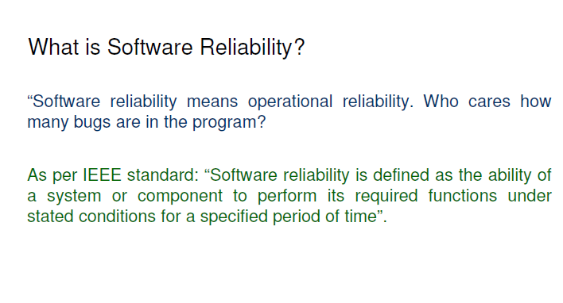
Software Reliability

Slide 3
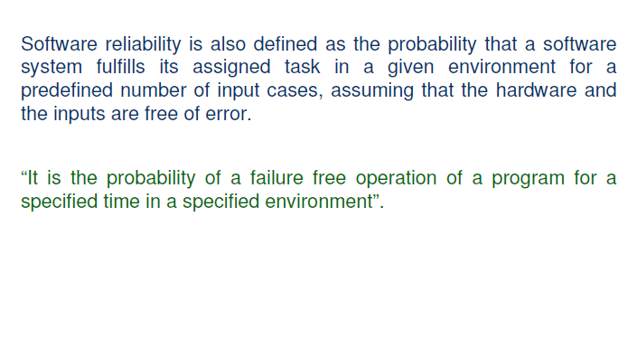
Software Reliability

Slide 4
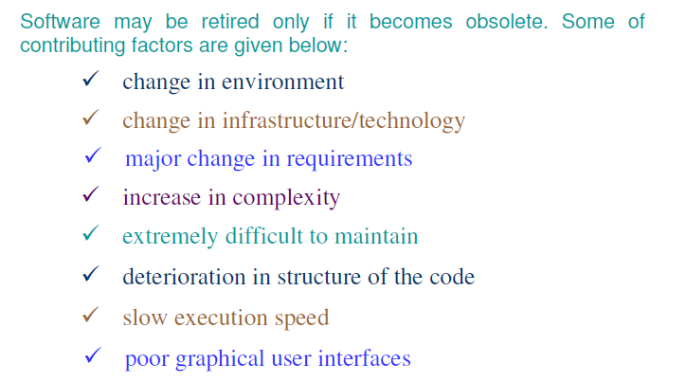
Software Reliability

Slide 5
Basic Concepts
There are three phases in the life of any hardware component i.e.,
burn-in, useful life & wear-out.
In burn-in phase, failure rate is quite high initially, and it starts
decreasing gradually as the time progresses.
2. During useful life period, failure rate is approximately constant.
3. Failure rate increase in wear-out phase due to wearing out/aging of
components.
The best period is useful life period. The shape of this curve is like a “bath tub” and that is why it is known as bath tub
curve.

Slide 6
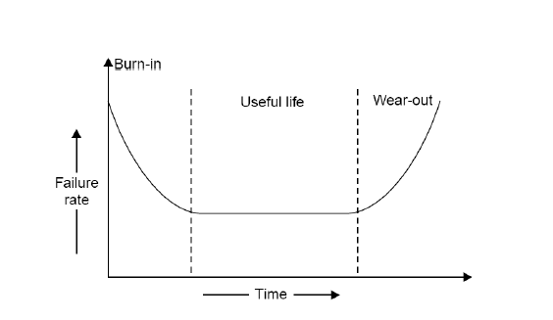
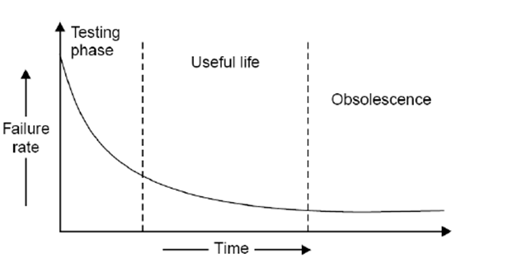
Reliability Curve
Hardware Reliability – Bath Tub curve
Software Reliability Curve

Slide 7
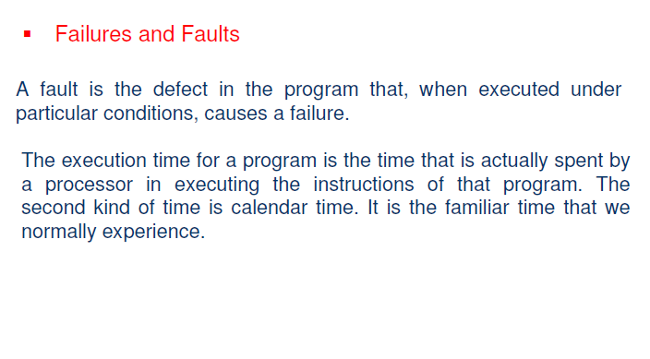
Software Reliability

Slide 8
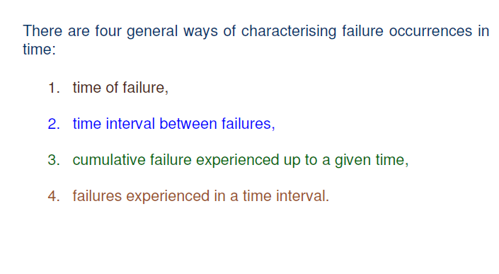
Failures and Faults

Slide 9
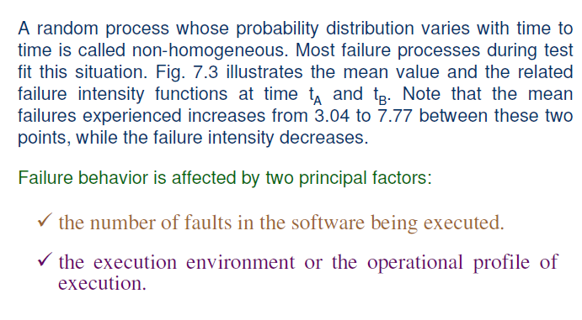

Slide 10
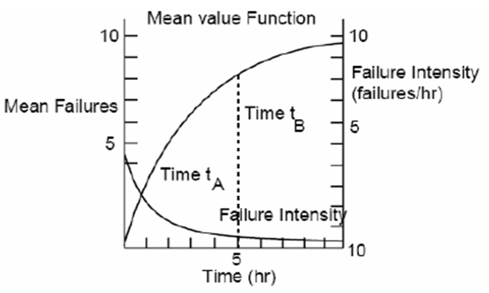
Failure behavior is affected by two principal factors:
the number of faults in the software being executed.
the execution environment or the operational profile of execution.
Mean Value & failure intensity functions.

Slide 11
Environment
The environment is described by the operational profile.
The proportion of runs of various types may vary, depending on the functional environment.
Examples of a run type might be:
A particular transaction in an airline reservation system or a business data processing system,
A specific cycle in a closed loop control system (for example, in a chemical process industry),
A particular service performed by an operating system for a user.
The run types required of the program by the environment can be viewed as being selected randomly. Thus, we define the operational profile as the set of run types that the program can execute along with possibilities with which they will occur.

Slide 12
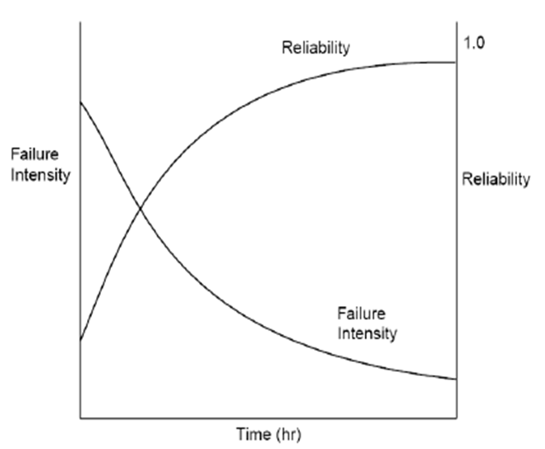
Variation of failure intensity and reliability as faults are removed

Slide 13
Uses of Reliability Studies
To evaluate software engineering technology quantitatively.
To evaluate development status during the test phases of a project.
To monitor the operational performance of software and to control new features added and design changes made to the software.
A quantitative understanding of software quality and the various factors influencing it and affected by it enriches into the software product and the software development process.

Slide 14
Software Quality
conformance to requirements
fitness for the purpose
level of satisfaction

Slide 15
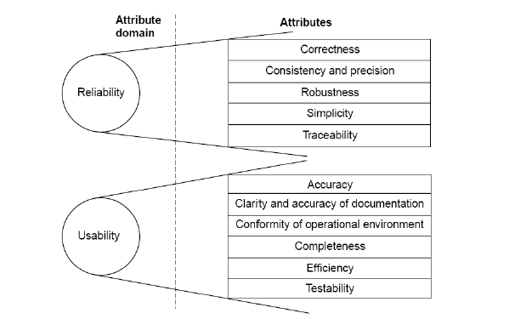
Software Quality attributes

Slide 16
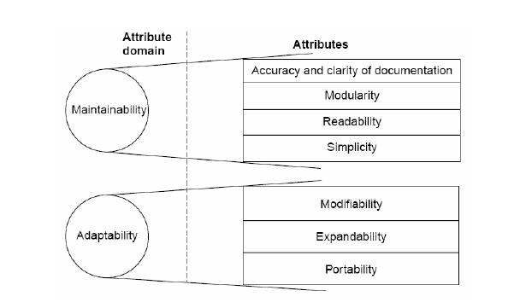
Software Quality attributes

Slide 17
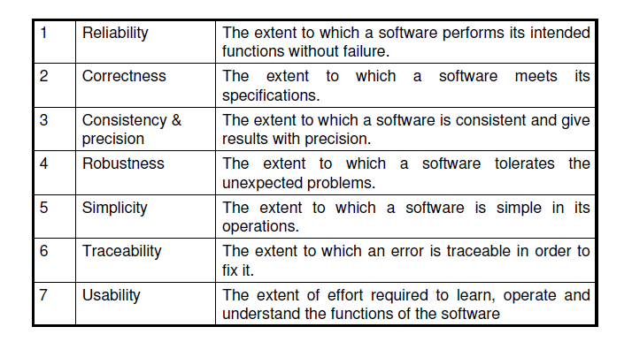
Software Quality attributes

Slide 18
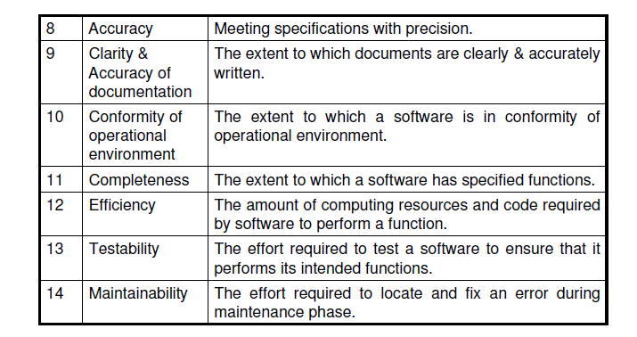
Software Quality attributes

Slide 19
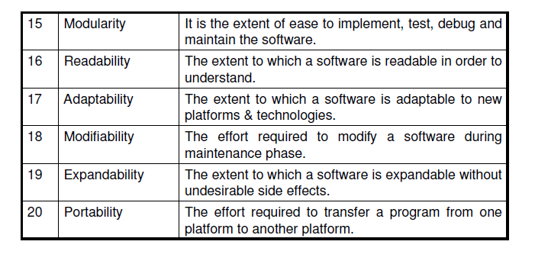
Software Quality attributes

Slide 20
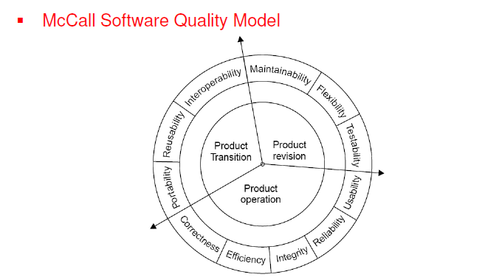
Software Reliability model – McCall Software Quality Model

Slide 21
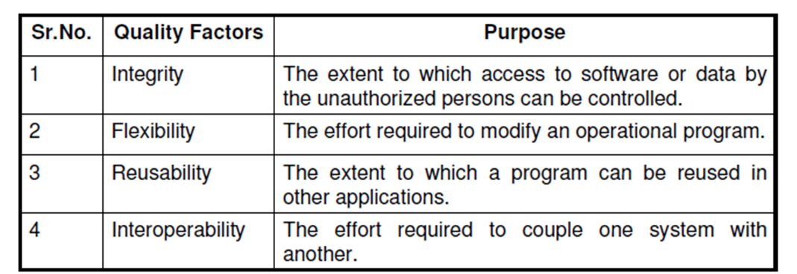
Quality Criteria

Slide 22
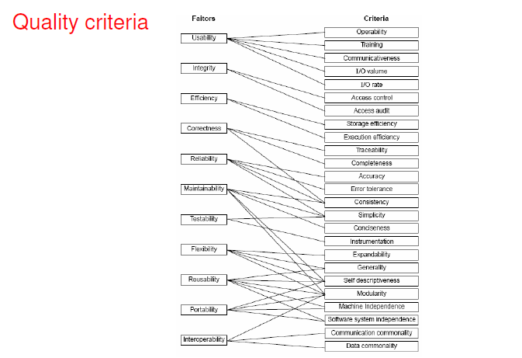

Slide 23
Product Operation
Factors which are related to the operation of a product are combined.
The factors are:
Correctness
Efficiency
Integrity
Reliability
Usability
These five factors are related to operational performance, convenience, ease of usage and its correctness. These factors play a very significant role in building customer’s satisfaction

Slide 24
Product Revision
The factors which are required for testing & maintenance are combined
These are :
Maintainability
Flexibility
Testability
These factors pertain to the testing & maintainability of software. They give us idea about ease of maintenance, flexibility and testing effort. Hence, they are combined under the umbrella of product revision.

Slide 25
Product Transition
We may have to transfer a product from one platform to an other platform or from one technology to another technology.
The factors related to such a transfer are combined and given below:
Portability
Reusability
Interoperability

Slide 26
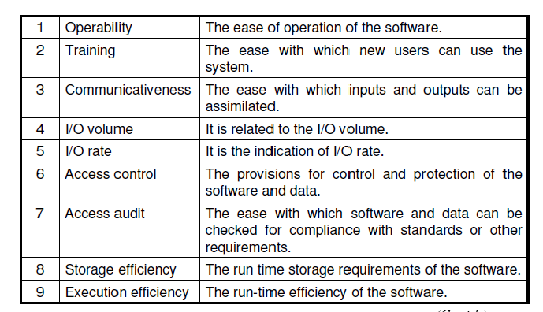
Software Quality Criteria

Slide 27
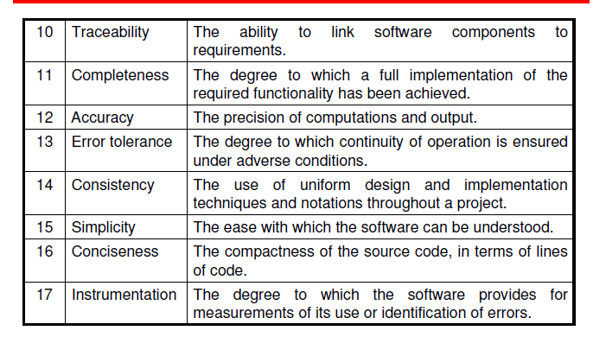
Software Quality Criteria

Slide 28
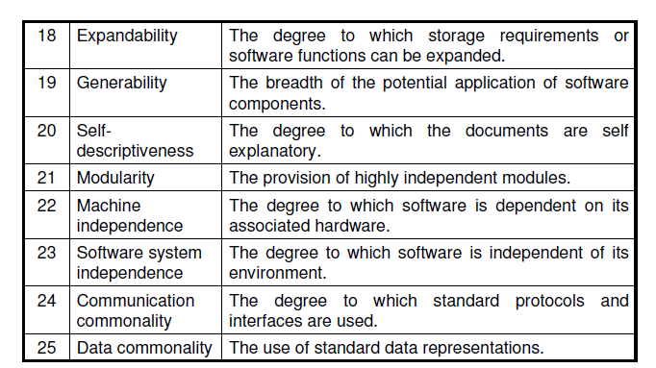
Software Quality Criteria

Slide 29
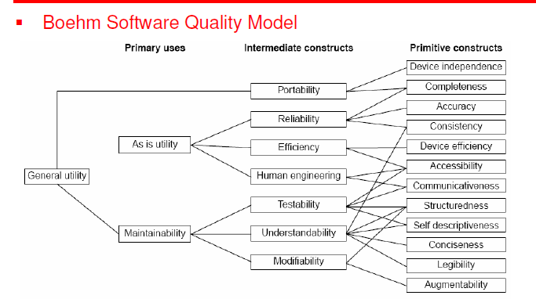
Boehm Software Quality model

Slide 30
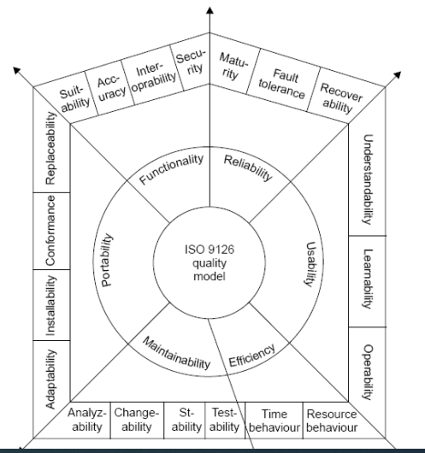
ISO 9126 quality model

Slide 31
ISO 9126-Software quality characteristics and attributes
Functionality
Reliability
Usability
Efficiency
Maintainability
Portability

Slide 32
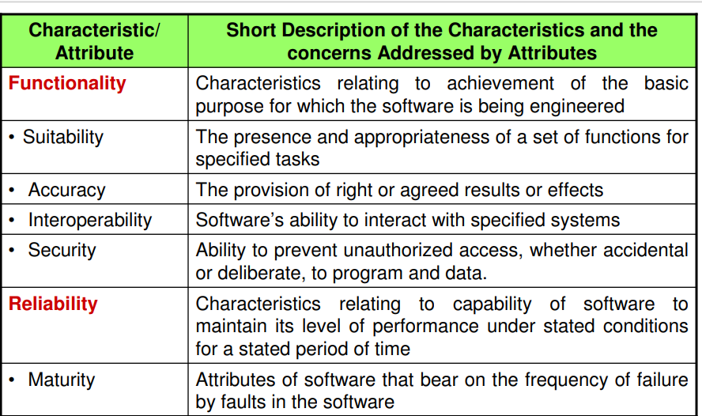
ISO 9126-Software quality characteristics and attributes

Slide 33
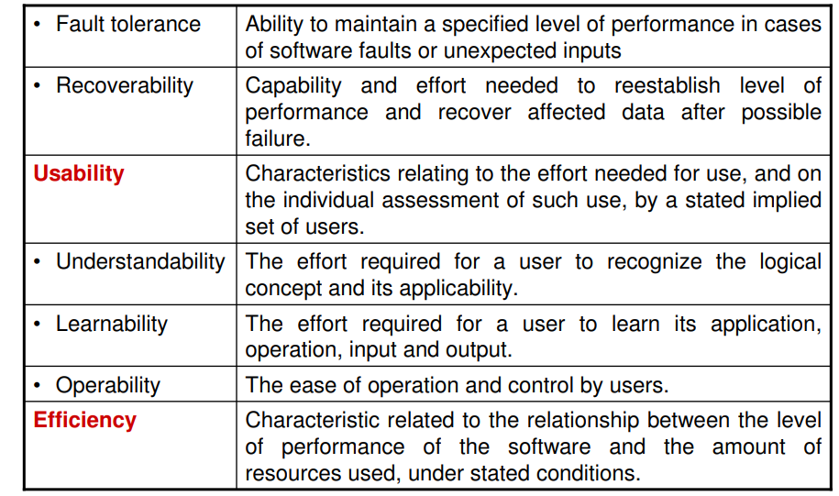
ISO 9126-Software quality characteristics and attributes

Slide 34
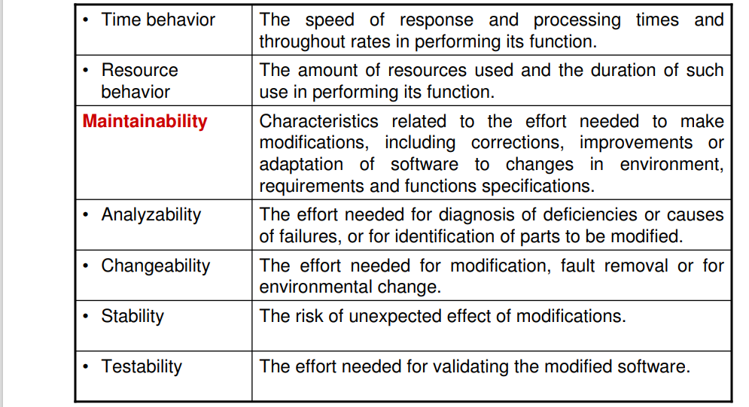
ISO 9126-Software quality characteristics and attributes

Slide 35
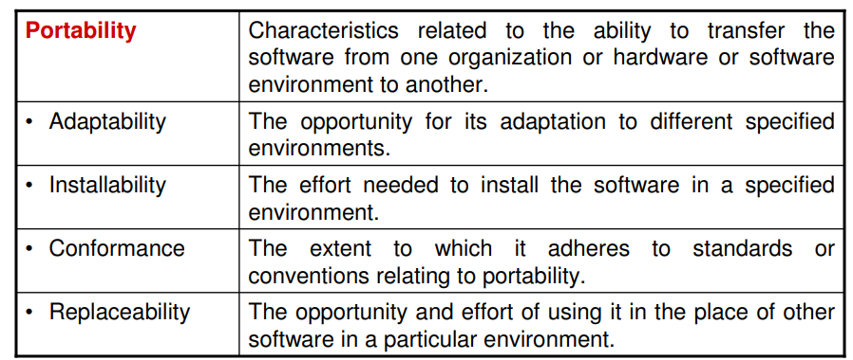
ISO 9126-Software quality characteristics and attributes

Slide 36
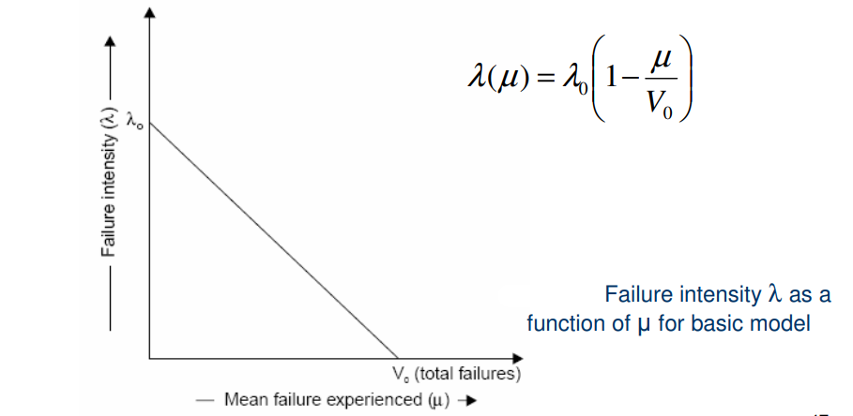
Basic Execution Time Model

Slide 37
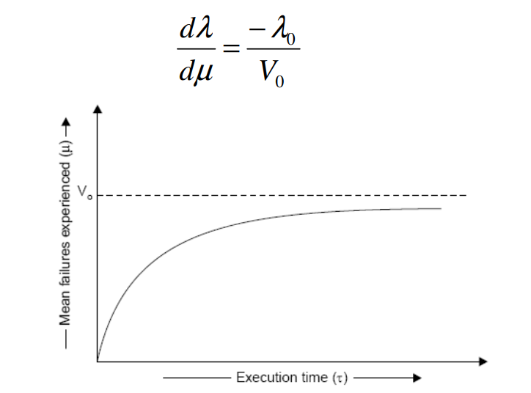
Relationship between & τ µ for basic model

Slide 38
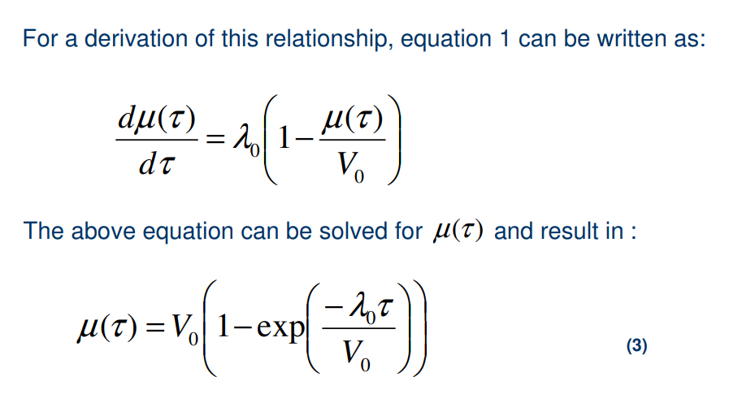

Slide 39
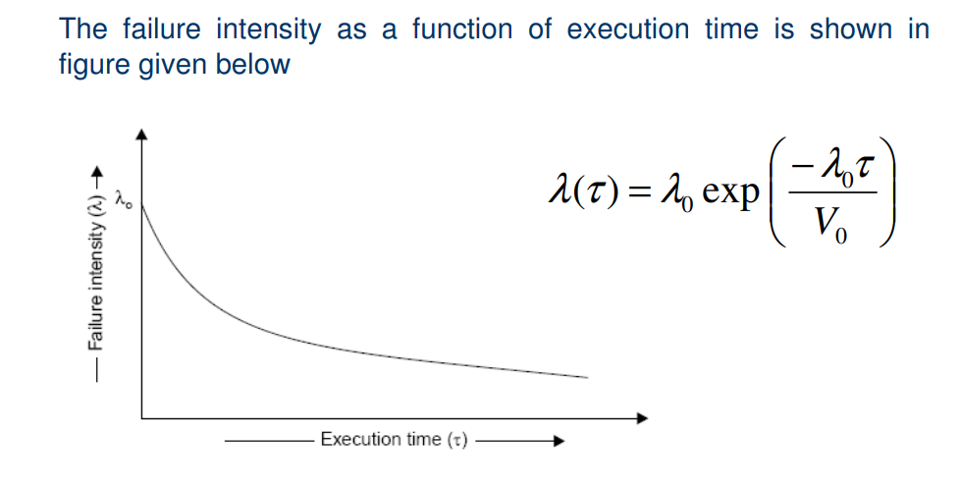
Failure intensity versus execution time for basic model

Slide 40
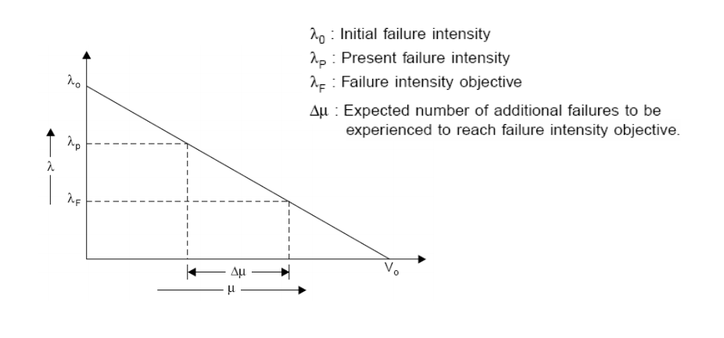
Derived quantities
Additional Failures required to be experienced to reach the objective

Slide 41
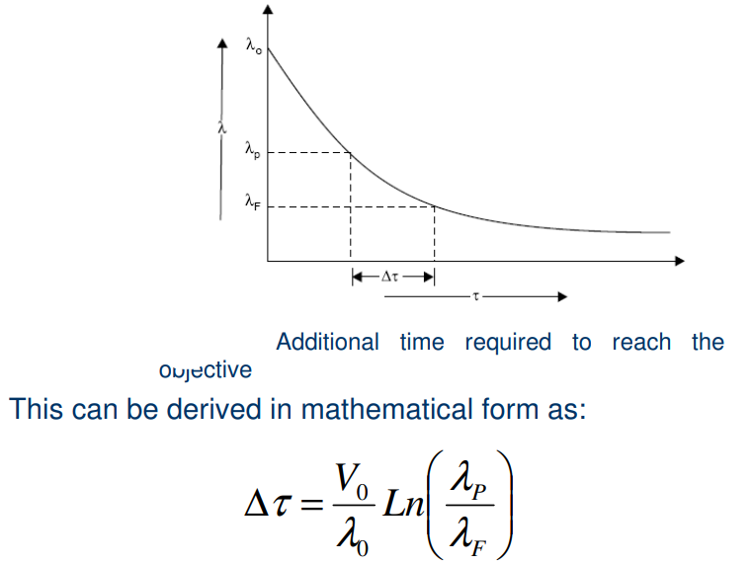
Additional time required to reach the objective

Slide 42
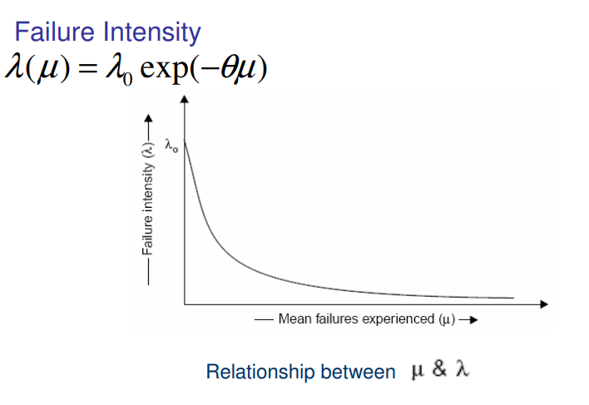
Logarithmic Poisson Execution Time Model

Slide 43
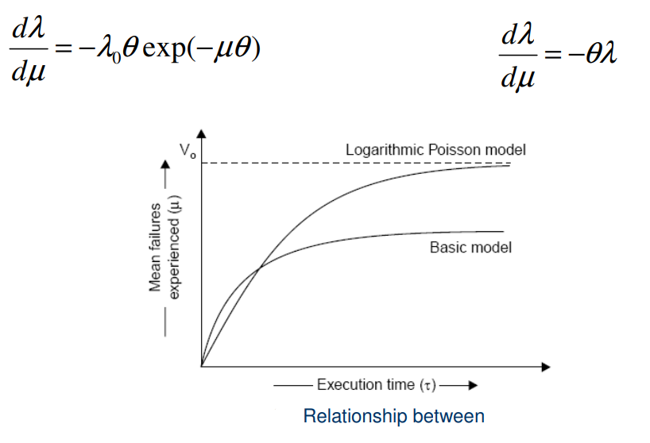
Logarithmic Poisson Execution Time Model
Mean failure experienced and Execution time

Slide 44
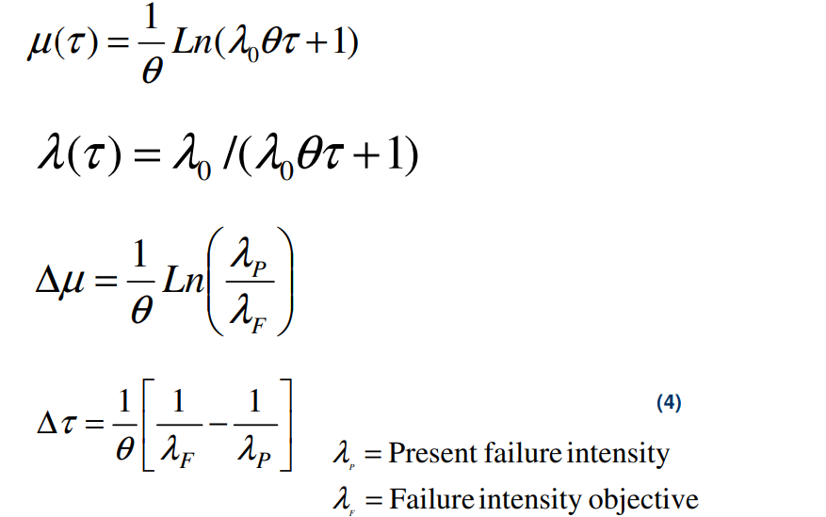

Slide 45
Calendar Time Component
The calendar time component is based on a debugging process model.
This model takes into account:
1. resources used in operating the program for a given execution time and processing an associated quantity of failure.
2. resources quantities available, and
3. the degree to which a resource can be utilized (due to bottlenecks) during the period in which it is limiting.

Slide 46
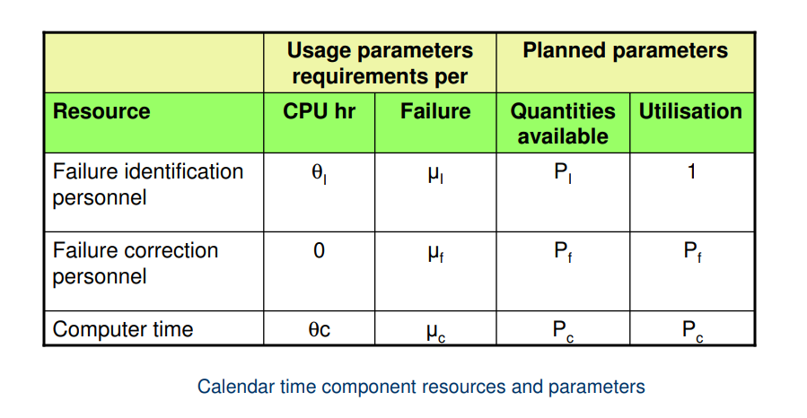
Resource usage

Slide 47
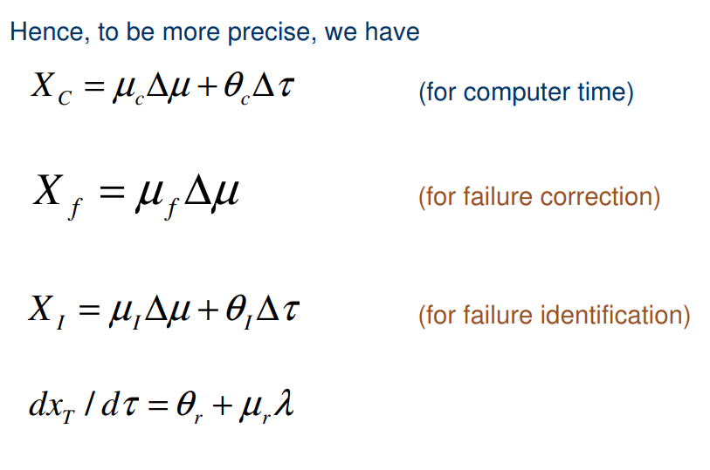
Calendar Time Component

Slide 48
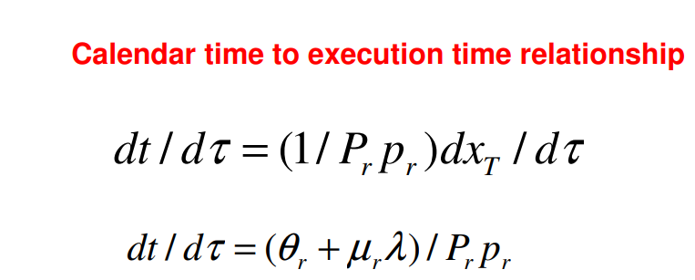
Calendar Time Component

Slide 49
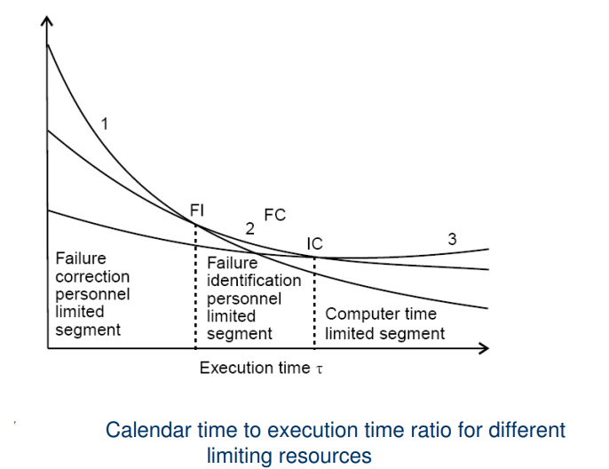
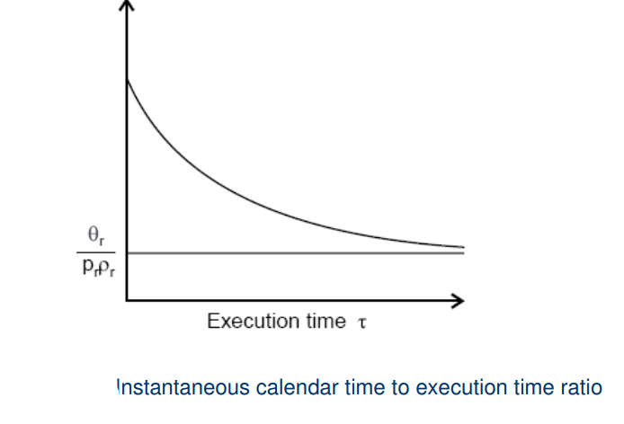
Calendar Time Component

Slide 50
Problem Statement
Assume that a program will experience 200 failures in infinite time. It has now experienced 100. The initial failure intensity was 20 failures/CPU hr.
(i) Determine the current failure intensity.
(ii) Find the decrement of failure intensity per failure.
(iii)Calculate the failures experienced and failure intensity after 20 and 100 CPU hrs. of execution.
(iv)Compute addition failures and additional execution time required to reach the failure intensity objective of 5 failures/CPU hr. Use the basic execution time model for the above mentioned calculations.

Slide 51
Problem Statement
Assume that the initial failure intensity is 20 failures/CPU hr. The failure intensity decay parameter is 0.02/failures. We have experienced 100 failures up to this time.
Determine the current failure intensity.
Calculate the decrement of failure intensity per failure.
Find the failures experienced and failure intensity after 20 and 100 CPU hrs. of execution.
Compute the additional failures and additional execution time required to reach the failure intensity objective of 2 failures/CPU hr.
Use Logarithmic Poisson execution time model for the above mentioned calculations.

Slide 52
Problem Statement
A team run test cases for 10 CPU hrs and identifies 25 failures. The effort required per hour of execution time is 5 person hr. Each failure requires 2 hr. on an average to verify and determine its nature. Calculate the failure identification effort required.

